Slide 1
Natural Language Generation
Presented By:
Aagat Ghimire - 191601
Aarya Paudel - 191602

Slide 2
01
Introduction
What is Natural Language Generation?

Slide 3
Introduction
Field of AI
Generating human-like language from machine-readable data
Enables computers to communicate in a way that feels natural
GPT-3 (Generative Pre-trained Transformer 3): state-of-the-art NLG model
NLTK (Natural Language Toolkit): Python library used for NLP and NLG.
1

Slide 4
02
Mathematical Concepts
The Math Behind NLG

Slide 5
Mathematical Concepts
n-gram models:
type of statistical language model commonly used in NLG
used to estimate probability of a sentence
based on probability of each word(s) occurring in sentence.
Formula:
P(w1, w2, ..., wn) = P(w1) * P(w2 | w1) * ... * P(wn | w{n-1}, ..., w{n-k+1})
where:
w1, w2, ..., wn -> words in the sentence,
P(wi | w{i-1}, ..., w{i-k+1}) -> probability of the i^{th} word given previous k-1 words.
2

Slide 6
Mathematical Concepts
Recurrent neural networks (RNNs):
designed to process sequential data
generate text one word at a time.
Formula:
ht = f(h{t-1}, xt)
where:
ht -> hidden state of the network at time t,
f -> activation function,
h{t-1} -> hidden state at time t-1,
xt -> input at time t.
3

Slide 7
Mathematical Concepts
Sequence-to-sequence (seq2seq) models:
Used for machine translation, text summarization
encoder network: reads input text and produces fixed-length representation of input
decoder network: generates output text based on encoder's representation
Formula:
p(y1, y2, ..., yT | x1, x2, ..., xS) = ∏{t=1}^T P(yt | y{<t}, ht)
where:
y1, y2, ..., yT -> words in output text,
x1, x2, ..., xS -> words in the input text,
ht -> hidden state of the decoder at time t,
P(yt | y{<t}, ht) -> probability of the t^{th} word given the previous words and the hidden state.
4

Slide 8
03
Algorithm
Computational models for NLG

Slide 9
Algorithm
NLG pipeline consists of:
data preprocessing
content determination
sentence planning
surface realization
Each performs specific function in NLG process.
Template-based algorithms: fill in pre-defined templates with relevant data
Rule-based algorithms: hand-crafted rules to generate natural language text
Statistical algorithms: learn patterns in large datasets, use patterns to generate new text.
5

Slide 10
Algorithm
Neural network algorithms: learn representations of natural language text to generate new text.
6

Slide 11
Algorithm
Example:
to generate a sentence describing weather in a particular city, using rule-based algorithm:
Identify city in question based on input data (e.g., “Butwal").
Retrieve current weather conditions for that city (e.g., "sunny and 40 degrees Celsius").
Apply set of hand-crafted rules to generate sentence that describes the weather:
If temperature >=20 and <=30 degrees, use adjective "pleasant".
If temperature >80 degrees, use adjective "hot".
If sky is clear, use adjective "sunny".
If sky is cloudy, use adjective "cloudy".
If it's raining, use phrase "it's raining".
Algorithm may generate sentence like "It's a hot and sunny day in Butwal today."
7

Slide 12
04
Code

Slide 13
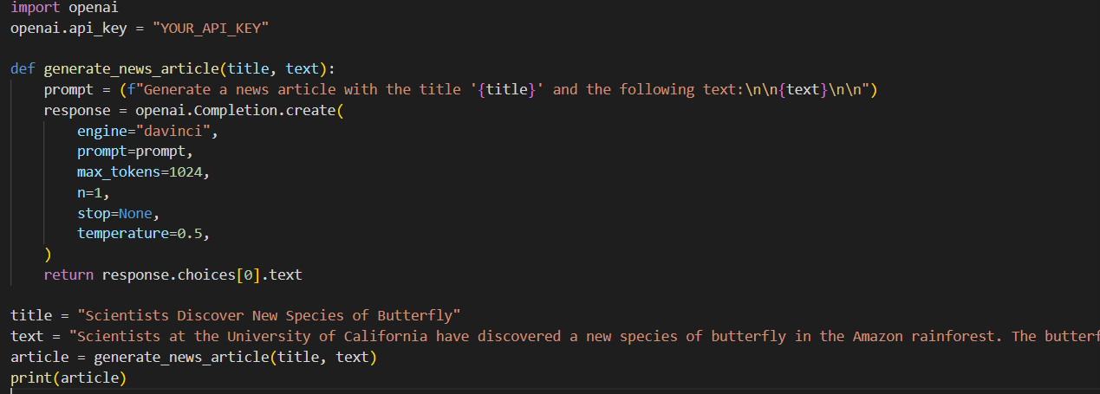
Code
GPT-3 API to generate article based on the input title and text.
generate_news_article sends prompt to API and receives response containing generated article text.
max_tokens controls length of generated text
temperature controls randomness of output."
8

Slide 14
05
Applications
Why NGL?

Slide 15
Applications
Chat-bots
Virtual assistants
Data-to-text generation
Language translation
Content generation
Accessibility
9

Slide 16
References

Slide 17
References
GPT-3 API documentation. (2021). OpenAI. https://beta.openai.com/docs/api-reference/introduction
Holland, J., & Hoskins, R. (2019). The Cambridge Handbook of Computational Psychology. Cambridge University Press. https://doi.org/10.1017/9781108654555
Natural Language Toolkit (NLTK) documentation. (2021). https://www.nltk.org/
Reiter, E., & Dale, R. (2000). Building Natural Language Generation Systems. Cambridge University Press. https://doi.org/10.1017/CBO9780511558113
Sharma, P., & Mahajan, M. (2019). Natural Language Generation: An Overview. International Journal of Scientific Research and Management, 7(1), 9012-9020. https://doi.org/10.18535/ijsrm/v7i1.05
10

Slide 18
Thank You

